Slide 1
Neighbourhood Working
Telford and Wrekin
November 2016

Slide 2
Scrutiny Committee
Introducing the approach
Priorities in each of the four neighbourhoods
Progress to date

Slide 3
1. Introducing the approach: Telford and Wrekin Model of Care
Notes:
This triangle represents the CCG’s priorities and model of care. They are alligned with the local authority priorities and outlined in a joint narrative between the council and the CCG
The top of the triangle relates to better supporting people in times of crisis including an improved response at A&E and in the community through the development of the new intermediate care service. This intermediate care service will be delivered by SaTH, T&W Council and Shrop Com and will be going live in October 2016
The bottom right hand point relates mainly to planned care, including the work being carried to improve cancer related pathways of care. This is relevant for the neighbourhood work as more interventions are carried out in community settings. It also fits in well with the work of the clinical design group to establish overarching pathways, which can be implemented at a local level
The priority around ‘community resilience’ and ‘Telford and Wrekin Neighbourhood Care Teams’ form the basis of the neighbourhood work. The vision for each and the rationale are explored more in the following slides

Slide 4
Who could be involved in neighbourhood working?
Target Population: Those with identified health risks.
Informal networks: Including friends, family, neighbours
Professionals supporting people through the formation virtual teams from;
Practice teams
Community nursing and therapy teams
Community pharmacies
Local Authority practitioners (e.g. Early help and support)
Community mental health teams
Third sector organisations
Outreach teams from acute settings
Carers
Links to more specialist teams for advice/guidance/ referral on

Slide 5
What is our approach to developing neighbourhoods
Building some prototypes around neighbourhoods.
Optimising the total resource in the neighbourhood
A community centred approach that increases access to community resources to meet health needs and increase social participation
Supporting the development of strong neighbourhoods that can work collaboratively to take action together on health and the social determinants of health
Needs to be locally determined and accept there are a variety of drivers for change and starting positions
Incremental and organic change
Support people properly to make the change (from front line staff to senior teams)
Empower a broader spectrum of people to support the transformation, rather than the ‘usual suspects’!
Notes:
Total resource - most importantly that which lies within people and the communities themselves
Community centred approaches - practical help, group activities, volunteering opportunities
Promotion of social connectedness as a route to achieve healthier more cohesive communities

Slide 6
What are the component parts of neighbourhood working?
Community resilience
Health and care communities (aligned with practices)
Transfer of acute services

Slide 7
What type of functions will be carried out within neighbourhoods?
Point of care testing
Delivery of ‘care’ (social/health)
Diagnostics
Surgery
Signposting
Support at end of life
Prevention, lifestyle advice & social prescribing
Support for people with complex needs
Outpatient clinics
………….But this could look different in different areas!

Slide 8
What areas will neighbourhoods cover?
The neighbourhoods will be based around groups of practice populations (usually between 30k and 50k)
These should be ‘natural neighbours’ and make sense for those working in and with the community
Three initial areas have been identified so far: Newport (2 practices), TELDOC (merger of 4 practices) and South Telford (6 practices)
Other practices are in discussions with each other and the CCG

Slide 9
What outcomes will we hope to achieve ?
People know how and feel able to live well
People feel connected with others - with friends and support networks
People have confidence to know, when their health concern is beyond their knowledge & skills, how to get support that is easy and proportionate to what their needs are
Our Care services enable and empower patients rather than create dependency
Our Care system delivers care right first time – better for patients and better for the system
Our Care services are able to deliver care in the most efficient way across the system – support the shift in care
Notes:
This area needs more work. We need to develop our aspirational outcomes with the community – what would good look like? In line with the community asset based approach, the experience needs to be different for those living in the area.
Local services – people only go to hospital if they absolutely have to!

Slide 10
2. Priorities in each of the four neighbourhoods

Slide 11
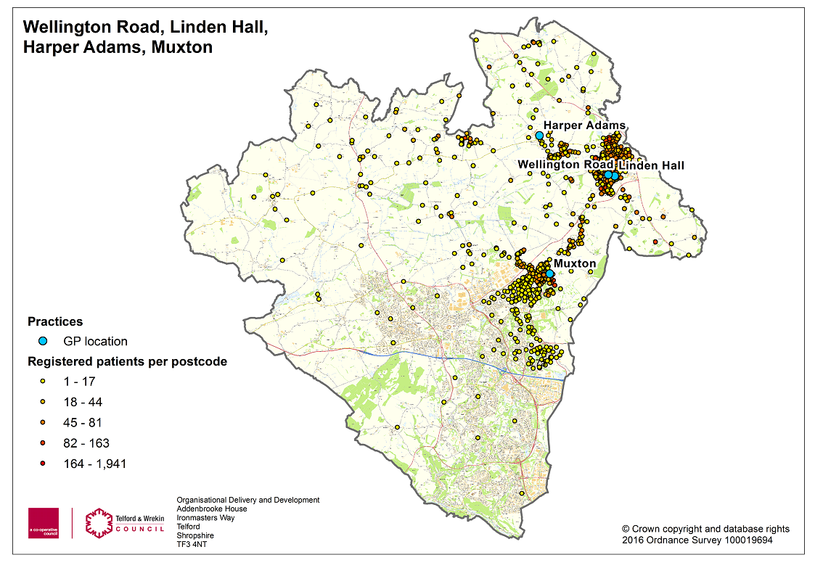
Newport Neighbourhood (approx 33,000 population)

Slide 12
Newport: Priorities for action
Integration of nursing, therapy and care workforce across a single area
Utilise a different model of care based on Buurtzorg principles
Align dementia related services with the practice
Map and better utilise community assets (including local buildings), accessed initially through social prescribing
Develop the local offer within this market town, including range of diagnostics and outpatient clinics
Better support to residential homes
Notes:
Integration – this would begin to breakdown some of the organisation/role boundaries. It will improve communication, mentoring, peer & professional support and career progression
Buurtzorg – the ‘neighnouhood’ will be meeting with ‘Public World’ who have partnered with Buurtzorg in the Netherlands to consider implementation in the UK
Dementia related services – further work will explore the development or new (or old!) roles such as health visiting type of workforce for people with dementia
Local offer – we would envisage a far greater shift from hospital settings than previously suggested

Slide 13
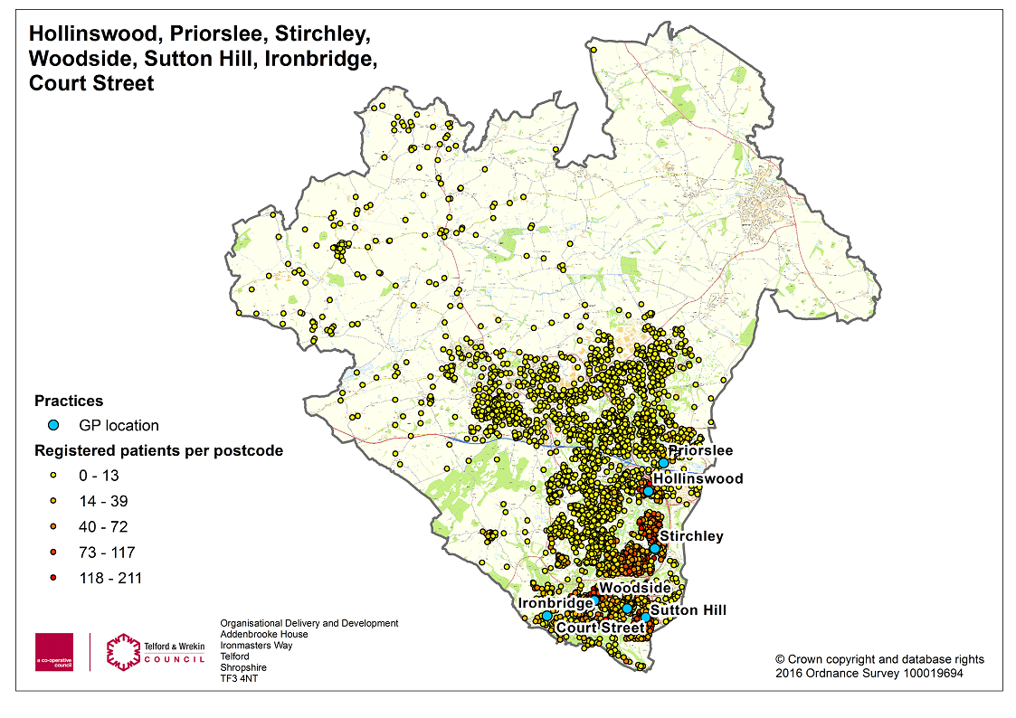
South Telford Neighbourhood (approx 44,000 population)

Slide 14
South Telford: Priorities for action
Integration of health and social care teams
Greater involvement of drug and alcohol services
Consideration of those aged 0-5, initially through improved alignment of health visiting
Implementation of creative support planning and other links with local authority teams
Notes:
Local authority teams – local pilots bringing together services around households, ‘neighbourhood teams’ proactively working with communities

Slide 15
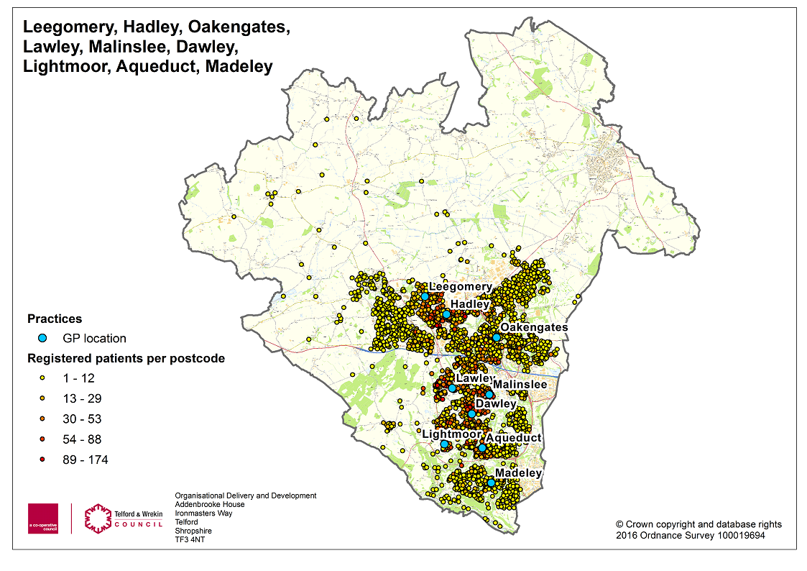
TELDOC: Trinity, Lawley, Dawley and Oakengates

Slide 16
TELDOC: Priorities for action
Merger of the four practices by April 2017
Social prescribing
Considering integration of health and social care
Improved urgent response for their patients
Provider of speciality based medicine to support the left shift

Slide 17
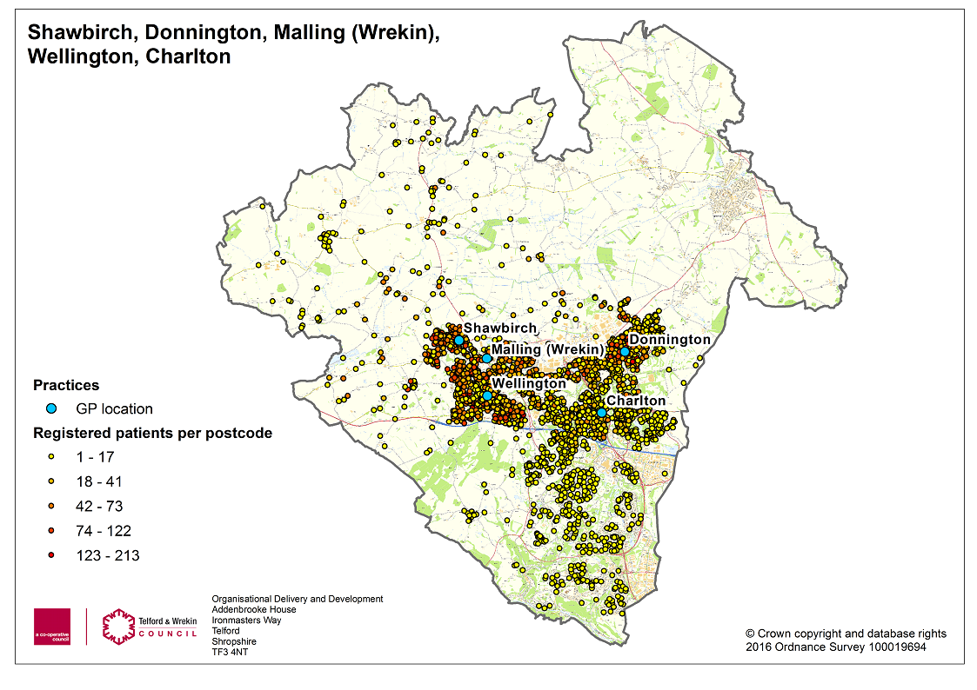
Locality 4 (for planning purposes only)

Slide 18
What additional resource will be required to support this change
Significant increase in community healthcare provision will be needed: Moving to the Buurtzorg model would suggest workforce needs to increase between two or three times
Investment to adapt existing facilities in community settings
Additional support from experts and ‘hands on’ support to manage the change
Investment to support sustainable change in community capacity
Resource needed to support ABCD
Properly resourced communication and engagement programme
Notes:
Buurtzorg – approximately 8-10 workers for 10,000 population (newport currently have 9 for a population of 33,000)
Facilities – the buildings in community need to be properly assessed. First thoughts are that the buildings are there but would need adapting to ensure they are fit for purpose
Experts required – ranging from contract experts to support practices, Buurtzorg consulant working with Public World
Community capacity – support in asset mapping, mobilising communities and one off funding

Slide 19
3. Progress to date

Slide 20
The Project Group
Healthwatch
LPC
Lead commissioning managers (CCG and LA)
GP chair
Chair of the SOG (third sector)
Shrop Com
Shrop Doc
SSSFT

Slide 21
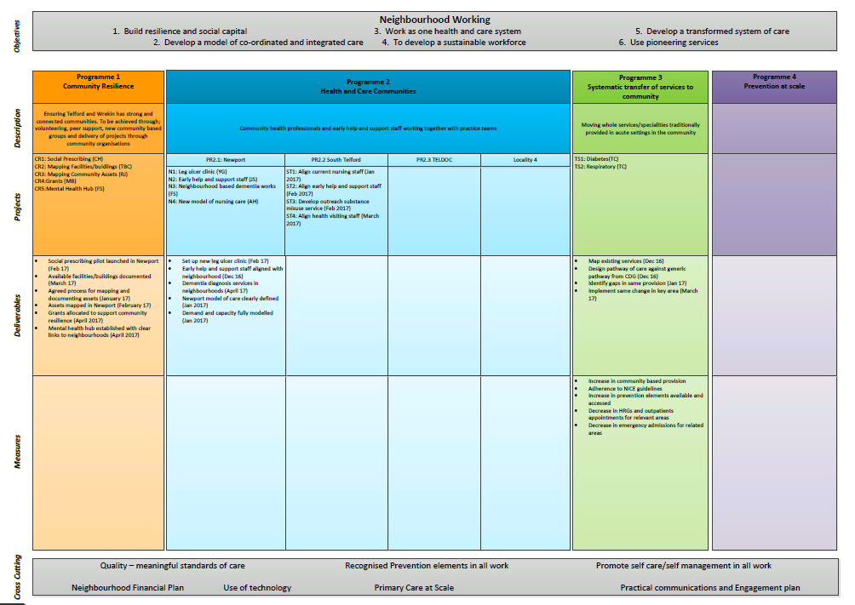
The PMO approach

Slide 22
Progress to date
Project group established
PMO with clear associated projects
Work progressing with Public World (partners to Buurtzorg Netherlands) and the Newport neighbourhood
Change of working in the Council and CCG so this becomes our ‘day job’
Asset mapping to begin in Newport asap
Roll out of social prescribing to start in Newport
Implementation of diabetes and respiratory pathways (from the clinical design group) has begun
Nursing Staff in Shrop Com identified who will align with some neighbourhoods
Discussion with the Health and Wellbeing Board

