Slide 1


Health & Wellbeing Board:
Priority workstream
Healthy Lifestyles
Whole-systems approach to tackling excess weight
Louise Mills
Service Delivery Manager
Health Improvement

Slide 2
For the Health & Wellbeing Board to:
Develop a shared understanding of the local excess weight issue
Identify and agree opportunities to provide systems leadership to secure collaboration in an area where despite efforts, progress is limited
To remain focused on practical actions that can make a real difference – actions that can be taken forward by the Health and Wellbeing Board, partners, officers, teams and communities
Each organisation around the table to own the issue and consider the role they can play
A nudge in the right direction.........

Slide 3
Key messages
Obesity is a complex issue. People that are obese or overweight tend to experience a number of issues, in addition to their weight, which present barriers to leading healthier lifestyles
It is essential for all partners to work together to tackle obesity and encourage people to live healthier lifestyles, given the complexity and scale of the issue
That the partnership approach to tackling obesity is strengthened across the public, private and voluntary sector in order to ensure
all organisations make the most effective use of their resources

Slide 4
What’s working well in Telford and Wrekin
Personalised advice and support – good outcomes, in line with best practice and national guidance
Support for the under 5’s – Healthy Mums, Healthy Start, Breastfeeding, parenting programmes, midwifery and Health Visiting
A number of schools are delivering activities to support healthy eating and lifestyle choices (school meals and the sport premium)
Parks, green space and good quality leisure provision
Good engagement with planning teams and local workplaces (start of the journey – not yet seeing the impact)
Transport team – Active Travel initiatives & Walking and Cycling Strategy
Many examples of innovative health improvement activity within our communities – often delivered at little or no cost
MECC training and signposting

Slide 5
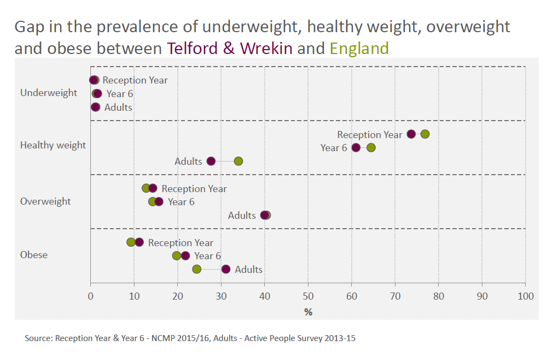

Slide 6
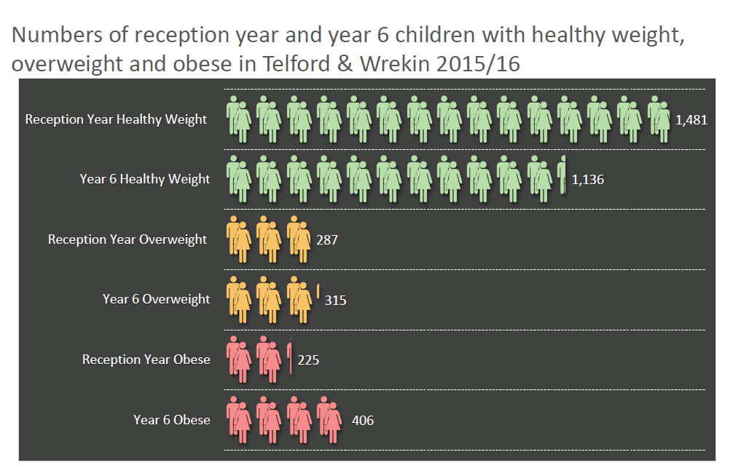

Slide 7
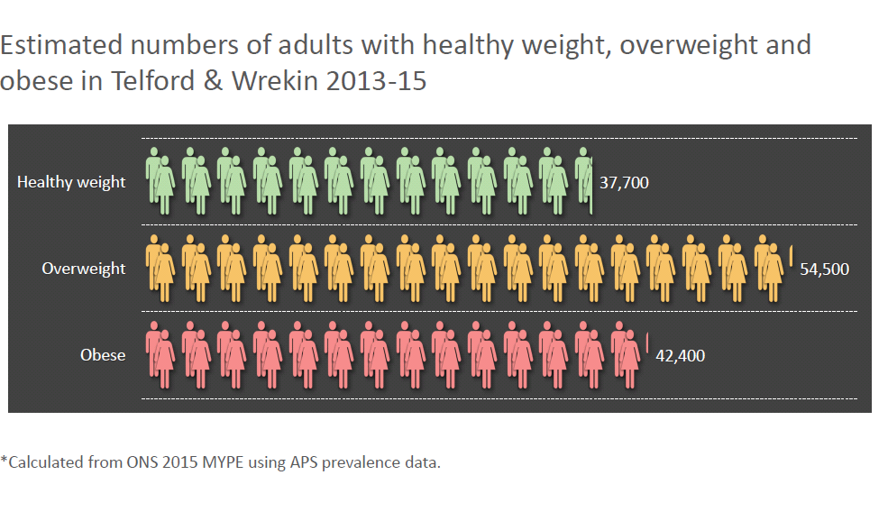

Slide 8
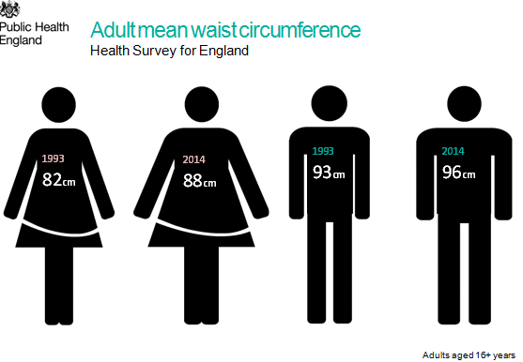

Slide 9
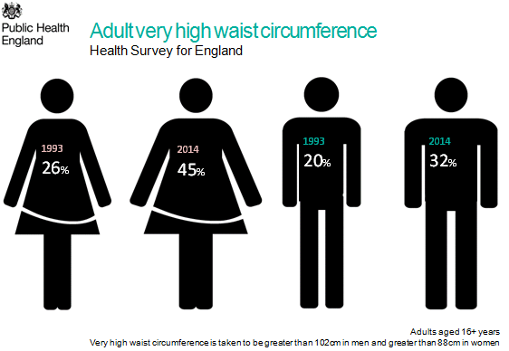

Slide 10
Understanding the challenge
We already have an understanding of the local prevalence of overweight and obesity
Obesity does not affect all groups equally
Obesity is more common among: people from more deprived areas, older age groups, some black and minority ethnic groups , people with disabilities
Next steps:
Further analysis to identify the priority groups who drive the costs
Further work required to understand why Telford and Wrekin are amongst the worse areas in the country for obesity
This will include: exploring the relationship between obesity and
deprivation, educational attainment and additional contributing factors (prevalence of fast food outlets), use of nationally published datasets will allow for comparison with other authorities

Slide 11
Leadership and governance
Current arrangements
Early Help Partnership Board
County Sports Partnership
School Sport Partnership
Neighbourhood working (STP) – prevention at scale
Question: Is this sufficient to tackle the challenge?
Could partners map their own sphere of influence?

Slide 12
Opportunities to influence action
Early Years and Schools
Health partners (Commissioning and providers of services)
Workplace
Commissioning

Slide 13
Early Years and Schools
Supporting Early Years settings (educating parents, physical activity and healthy eating)
Helping all children to enjoy an hour of physical activity every day at school
Improving the coordination of quality sport and physical activity programmes
Walking and cycling to school
System levers......
Allocation of the Primary PE and Sport Premium
New Healthy Rating Scheme for primary schools (voluntary Sept 2017)
Encouraging all schools to commit to the School Food Standards
Ofsted thematic review (2017) good practice and recommendations for schools

Slide 14
Working with health partners
Improve weight management services (tier 3 and 4)
Links to the NHS Diabetes Prevention Programme
Deliver effective brief advice on physical activity in Clinical Care
(PHE Clinical Champions Programme)
Supporting behaviour change campaigns (Change4Life and One You)
Neighbourhood working – social prescribing
MECC training – Health and Care professionals empowering healthier lifestyle choices and improving access to relevant and appropriate services
Workplace setting and as an employer – staff health and wellbeing
Incorporating Government Standards for Food and Catering Services (across patients, staff and visitor catering)
System levers...
CQUIN
STP and Neighbourhood working

Slide 15
Workplace
Creating healthier and more productive workplaces – focus on NHS, local authority and small and medium enterprises where there is the greatest potential for improvement
System levers....
Staff Health and Wellbeing CQUIN
Health related staff absence

Slide 16
Through commissioning
Explore opportunities to develop and implement a ‘Public Health Gain Schedule’ across all health and care contracts (could be broader)
Could we consider implementing a Public Health Gain Schedule setting out the minimum criteria:
Implementation of the Food Standards
Demonstrate a commitment to employee health and wellbeing
A proportion of public facing staff to complete MECC training (with signposting to healthy lifestyle support services)

Slide 17
Any questions?
Comments
Discussion

